Slide 1
Machine Learning Algorithms
KNN, Random Forest, Naive Bayes, Gradient Boosting

Slide 2
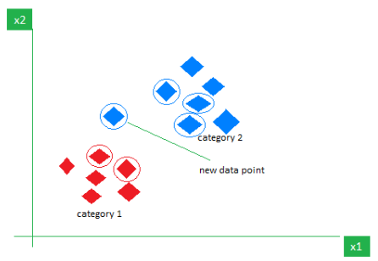
K-Nearest Neighbor(KNN) Algorithm
Instance-based learning: No explicit model is created.
Stores the entire training dataset in memory.
Prediction step:
Calculate distance from the new data point to all stored points.
Select the K closest neighbors.
Majority voting (classification) or averaging (regression).
K-Nearest Neighbors is also called as a lazy learner algorithm because it does not learn from the training set immediately instead it stores the dataset and at the time of classification it performs an action on the dataset.
The image shows how KNN predicts the category of a new data point based on its closest neighbours.

Slide 3
What is 'K' in K Nearest Neighbour?
The number of nearest neighbors considered for making a prediction.
Example: Imagine you're deciding which fruit it is based on its shape and size.
You compare it to fruits you already know.
If k = 3, the algorithm looks at the 3 closest fruits to the new one.
How to choose the value of ‘k’ for KNN Algorithm?
K = number of neighbors considered for prediction.
Small K → sensitive to noise (overfitting).
Large K → oversmoothing, may miss patterns
(underfitting).
Choose K based on data characteristics.
Statistical Methods:
Cross-Validation –
Split data into k folds, train & test repeatedly.
Pick K with highest average accuracy.
Elbow Method –
Plot error/accuracy vs. K.
Select K at the "elbow" where improvement slows.
Odd Values for Classification –
Avoid ties in majority voting.

Slide 4
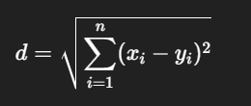
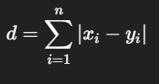

Distance Metrics in KNN Algorithm
Purpose: Distance metrics help identify the nearest neighbor for classification & regression in KNN.
1. Euclidean Distance
Straight-line distance between two points in space.
Think of it as the shortest path between two points.
2. Manhattan Distance
Total distance traveled along horizontal & vertical lines (grid-like).
Also called taxicab distance.
3. Minkowski Distance
Generalized distance metric (covers Euclidean & Manhattan).
Minkowski distance is essentially a flexible formula that can represent
either Euclidean or Manhattan distance depending on the value of p.

Slide 5
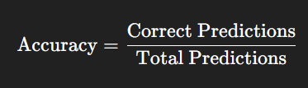
Performance Evaluation in KNN Algorithm
Regression Metrics (if KNN is used for regression)
Mean Squared Error (MSE) – Penalizes larger errors more.
Root Mean Squared Error (RMSE) – Square root of MSE; interpretable in original units.
Mean Absolute Error (MAE) – Average of absolute prediction errors.
Classification Metrics
Accuracy – Measures overall correctness.
Precision – Fraction of positive predictions that are correct.
Recall (Sensitivity) – Fraction of actual positives correctly identified.
F1-Score – Harmonic mean of precision & recall; balances the two.
Confusion Matrix – Shows true positives, false positives, true negatives, false negatives.

Slide 6
Use Cases & When to Use KNN
1. Healthcare – Disease Diagnosis (e.g., Diabetes Detection)
Patient’s medical data (e.g., glucose levels, BMI, age) compared with past patient records.
KNN finds similar patient cases and predicts the likelihood of having the disease.
Used for quick, interpretable diagnosis support.
2. Finance – Credit Scoring & Fraud Detection
Customer’s financial history compared with similar past customers.
For credit scoring: predicts default risk based on repayment history of similar profiles.
For fraud detection: detects unusual transactions by comparing with typical spending patterns.
3. Image Recognition – Handwritten Digit Classification (MNIST)
Pixel values of a new image compared with stored images in dataset.
KNN assigns digit label based on the most common label among the nearest matches.
Works well for smaller image datasets where pattern matching is effective.
When to Use KNN:
Data is small to medium-sized.
Data is not high-dimensional (curse of dimensionality affects performance).
Relationships between features are nonlinear.
You can afford slower predictions but need simple implementation.

Slide 7
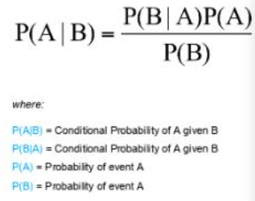
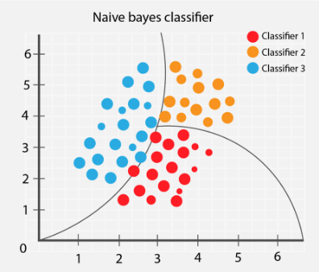
Naive Bayes Classifiers
Naive Bayes is a classification algorithm which checks the probability of a test point belonging to a class. Unlike other algorithms, Naive Bayes is purely a classification algorithm.
Probabilistic classifier based on Bayes’ Theorem
“Naive” because it assumes features are conditionally independent given the class.
Class prediction = choose class with maximum posterior probability (MAP estimation).

Slide 8
Key Features
Simple & fast – works well with large datasets.
Probabilistic output – gives likelihood for each class.
Works well with categorical & text data.
Robust to irrelevant features.
Requires small amount of training data.
Assumption of Naive Bayes
Conditional independence: All features contribute independently to the probability of the output class. Example: In spam detection, presence of the word “offer” is assumed independent from “free” given the spam class.
Types of Naive Bayes models:
Gaussian Naive Bayes → For continuous data (assumes normal distribution)
Multinomial Naive Bayes → For count-based features (e.g., word counts in text)
Bernoulli Naive Bayes → For binary features

Slide 9
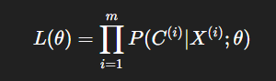
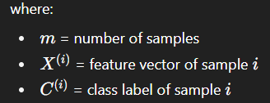


Cost Function in Naive Bayes
Naive Bayes is a generative probabilistic model — meaning it models the joint probability P(X,C)P(X, C)P(X,C) and then uses Bayes’ theorem to compute P(C∣X)P(C|X)P(C∣X).
It’s not trained via gradient descent like neural networks, so there’s no “loss function” in the usual sense. Instead, it’s trained by estimating parameters (probabilities) using Maximum Likelihood Estimation (MLE) or Maximum A Posteriori (MAP) estimation.
Maximum Likelihood Estimation (MLE)
We want parameters θ\thetaθ (probabilities) that maximize:
In practice, we work with log-likelihood (to avoid underflow from multiplying small probabilities):
Negative Log-Likelihood (NLL)
If we want to phrase it like a cost function (to be minimized):
Goal: Minimize NLL → equivalent to maximizing the likelihood.

Slide 10
Performance Evaluation Metrics
Accuracy → % of correct predictions (good for balanced datasets)
Precision → How many predicted positives are actually correct
Recall → How many actual positives are correctly identified
F1-score → Balance between precision and recall (good for imbalanced datasets)
ROC-AUC → Measures ability to separate classes across all thresholds
Notes:
Use Precision/Recall/F1 for imbalanced data instead of only Accuracy
Naive Bayes is fast, but performance drops if feature independence assumption is violated

Slide 11
Use Case & When to Use:
Spam Email Detection
Classifies emails as spam or not spam using word frequency features.
Works well with high-dimensional text data.
Sentiment Analysis
Determines if a review, tweet, or comment is positive, negative, or neutral.
Efficient for large-scale natural language processing tasks.
Medical Diagnosis
Predicts the likelihood of a disease based on symptoms.
Effective when conditional independence between symptoms is a reasonable assumption.
When to Use Naive Bayes:
1. Strong performance with high-dimensional data
In text classification (spam filtering, sentiment analysis), features (words) are numerous but often weakly dependent, which fits the independence assumption reasonably well.
2. Very fast training & prediction
No iterative optimization — just count-based probability estimation (for discrete) or mean/variance estimation (for continuous).
3. Works well with small datasets
Even with limited training data, probability estimates are reliable due to frequency-based calculation.
4. Robust to irrelevant features
Irrelevant features have little effect because probabilities get multiplied, and irrelevant terms tend toward neutrality.

Slide 12
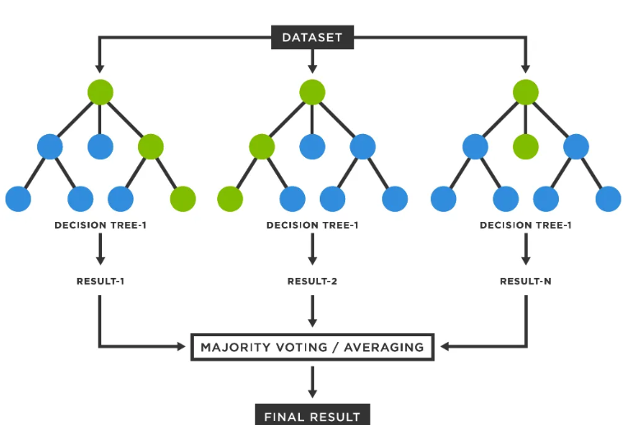
Random Forest Algorithm
Ensemble algorithm combining multiple decision trees for improved accuracy & robustness.
Designed to reduce overfitting compared to a single Decision Tree (CART).
Key Difference from CART
Random Forest: Multiple trees, each trained on random subsets of data & features → aggregation improves prediction.
CART: Single tree trained on entire dataset → more prone to overfitting.
Core Concepts
Bagging (Bootstrap Aggregating):
Create random samples (with replacement) from training data.
Train each tree on a different sample.
Combine predictions for final output.
Random Subspace Method:
Randomly select a subset of features for each tree.
Encourages diversity among trees and improves generalization.
Hyperparameters to Tune
n_estimators → Number of trees; more trees = more stable, but slower.
max_depth → Controls tree size; limits overfitting.
max_features → Number of features considered at each split; controls tree diversity.
min_samples_split / min_samples_leaf → Minimum data points required to split or be a leaf.
bootstrap → Whether sampling with replacement is used.

Slide 13
Random Forest Overcomes Overfitting
1. Bootstrapping (Bagging)
Each tree is trained on a random sample (with replacement) of the training data.
Because every tree sees slightly different data, they learn different patterns, reducing the chance of all trees overfitting to the same noise.
2. Random Feature Selection
At each split, only a random subset of features is considered.
Prevents dominant features from always driving splits in every tree.
Ensures diversity among trees, making the combined prediction more generalizable.
Why this works:
Individual decision trees can overfit by memorizing noise in the training set.
By averaging (regression) or voting (classification) across many de-correlated trees, Random Forest smooths out these noisy patterns.
This reduces variance without significantly increasing bias.

Slide 14



Split Decisions & Performance Metrics
Classification:
Gini Impurity: → Lower value = purer node.
Entropy (Information Gain): → Split chosen to maximize information gain.
Regression:
Mean Squared Error (MSE): → Measures average squared prediction error.
For Classification:
Accuracy → % of correct predictions. Precision → Of predicted positives, how many are correct.
Recall (Sensitivity) → Of actual positives, how many were found.
F1-Score → Balance between precision & recall.
ROC-AUC → Ability to separate classes.
For Regression:
MAE → Average absolute error.
MSE → Penalizes large errors more.
RMSE → Error in original units.
R² Score → Variance explained by model.

Slide 15
Use Cases & When It Is Used
1. Healthcare – Disease Prediction (e.g., Diabetes, Cancer Risk)
Can handle complex interactions between patient features (age, blood pressure, genetic markers).
Identifies important health indicators via feature importance.
Robust against noisy or incomplete medical records.
2. Finance – Credit Scoring & Fraud Detection
Detects non-linear patterns in spending/transaction data.
Works well with imbalanced datasets (fraud cases are rare).
Reduces overfitting, making predictions more reliable for risk assessment.
3. E-commerce – Product Recommendation
Captures customer behavior patterns from mixed numerical (age, purchase frequency) and categorical (product category) data.
Handles large feature sets to suggest relevant products.
Improves personalization accuracy without heavy feature engineering.
When to Use:
When you have tabular data with mixed numeric/categorical variables.
When accuracy is more important than model interpretability.
When the dataset is large, complex, and non-linear.
When you want feature importance insights.
When you need a robust model resistant to overfitting.

Slide 16
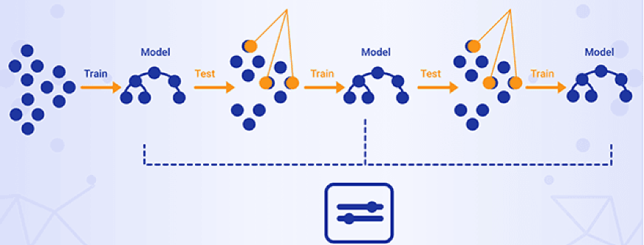
Gradient Boosting
Type: Ensemble learning method for classification & regression.
Approach: Boosting — combines multiple weak learners to form a strong model.
Process:
Models are trained sequentially.
Each new model corrects the errors of the previous one.
Optimization:
Uses a loss function (e.g., Mean Squared Error, Cross-Entropy).
Minimizes loss via gradient descent.
Iterations:
Compute gradient of loss w.r.t. predictions.
Train a weak model to fit this gradient.
Add new model’s predictions to
the ensemble.
Stopping Criteria:
Number of iterations reached or
no further improvement.

Slide 17
Working of Gradient Boosting
Sequential Learning Process
Multiple trees are trained sequentially.
Each tree corrects the errors of the previous one.
First tree → trained on original data (x) & labels (y).
Residuals Calculation
Next tree → trained on original features (x) & residual errors from previous tree.
Process repeats until all trees are trained.
Shrinkage (Learning Rate)
After training, each tree’s predictions are multiplied by a learning rate (η ∈ [0, 1]).
Reduces overfitting by limiting each tree’s influence.
Final prediction = sum of all trees’ scaled predictions.
When to use Gradient Boosting
When you need high accuracy on structured/tabular data.
When dataset contains non-linear relationships.
When data has mixed feature types (numeric + categorical).
When interpretability is less important than performance.
When computational resources are available (can be slower to train).

Slide 18
Variants of Gradient Boosting
Performance Evaluation
XGBoost (Extreme Gradient Boosting)
Adds regularization (L1/L2) to prevent overfitting.
Highly optimized for speed & performance.
Widely used in Kaggle competitions and industry projects.
LightGBM
Uses leaf-wise tree growth and histogram-based splitting.
Very fast and memory efficient, works well with large datasets.
Can handle both numerical and categorical data.
CatBoost
Specially designed for categorical features (no need for manual encoding).
Automatically handles overfitting using ordered boosting.
Works well with imbalanced datasets.
For Classification:
Accuracy – Proportion of correct predictions.
Precision, Recall, F1-Score – Useful when classes are imbalanced.
ROC-AUC – Measures model’s ability to separate classes.
Log Loss (Cross-Entropy Loss) – Penalizes wrong predictions with high confidence.
For Regression:
Mean Squared Error (MSE) – Average squared difference between predicted & actual values.
Root Mean Squared Error (RMSE) – Square root of MSE, interpretable in same units as target.
Mean Absolute Error (MAE) – Average absolute difference between predictions and actuals.
R² Score (Coefficient of Determination) – Proportion of variance explained by the model.

Slide 19
Use Cases
1. Finance – Credit Scoring & Fraud Detection
Credit Scoring: Evaluates a customer’s probability of default using historical repayment data and other financial indicators.
Fraud Detection: Identifies unusual transaction patterns and flags suspicious activity in real time.
Advantage: Handles complex, non-linear interactions in financial features, improving prediction accuracy over linear models.
E-commerce – Product Recommendations & Churn Prediction
Product Recommendations: Predicts the likelihood of a customer purchasing specific products based on browsing and purchase history.
Churn Prediction: Identifies customers likely to stop using the platform, enabling targeted retention campaigns.
Advantage: Can process both categorical (product categories) and numerical (purchase frequency) data effectively.
Healthcare – Disease Risk & Readmission Prediction
Disease Risk Prediction: Estimates the likelihood of developing diseases (e.g., diabetes, heart disease) using patient records and lifestyle data.
Readmission Forecasting: Predicts whether a patient will return to the hospital within a certain period after discharge.
Advantage: Handles large, heterogeneous datasets and captures subtle interactions between clinical variables.

